Slide 1
Business Process Review
A business process review examines the effectiveness and efficiency of an enterprise in meeting its goals and objectives.
Inefficient or outdated business processes may pose a risk by .
When responding to risk, the organization should review its business processes to ensure that the correct solution is selected to integrate and work effectively with the existing environment, or whether the environment should be reengineered to improve its efficiency and success in meeting organizational objectives.
  The purpose of the business process review is to identify ways to:
    Identify problems or issues with the current process
    Gather information toward improving processes
    Prepare a road map to implement required changes
    Assign responsibility and accountability for projects
    Schedule individual projects according to priority
    Monitor project progress for attainment of milestones and production of deliverables
    Review and obtain feedback on project results
    Verify compliance to standards and policies

Slide 2
The steps of a business process review are:
  1. Document and evaluate current business processes,
    List critical processes, supply chains and services
    Document current business processes and risk
    Validate training and skills required of personnel
    Document identified issues and problems
    Baseline other organizations
    Work with team members to discover potential solutions and improvements
  2. Identify potential changes
    a. Use focus groups and workshops to determine process improvements
    b. Validate proposed changes with management and obtain approval to proceed
  3. Schedule and implement changes
    a. Design changes
    b. Identify dependencies
    c. Communicate the schedule of changes
  4, Feedback and evaluation
    a. Measure operational efficiencies
      i, Customer satisfaction
      ii, User satisfaction
      ii, Improvements in productivity/quality
      iv. Feedback to improve processes

Slide 3
Risk Management Principles, Processes and Controls
  Risk management exists to support the enterprises
  The risk practitioner should consider the impact of processes and controls on the ability of the business to meet its objectives and of users to accomplish their tasks in a simple, logical manner.
  The risk practitioner should present this information to the risk owner in a way that allows them to weigh these considerations against the consequences associated with the risk.

Slide 4
Principles of Risk Management
  While there is a strong reliance on information and related technologies used within the enterprise, risk originating from IT, information security and cybersecurity is not the only risk that requires the attention of risk practitioners.
  Risk originating from various lines of business exists such as risk associated with process failures, need to be considered and ultimately managed.
  Any threat that has the potential for preventing the enterprise from meeting their defined business goals and objectives should be managed from the perspective of overall enterprise objectives, and thus falls under the guiding principles of the Risk IT Framework
  which include:
      Align management of IT-related risk to business or mission objectives.
      Align the management of IT-related business risk with ERM when possible.
      Balance the costs and benefits of managing IT-related risk.
      Promote ethical and open communication of all IT-related risk.
      Establish the tone at the top while defining and enforcing personal accountability for operating within acceptable and well-defined tolerance levels.

Slide 5
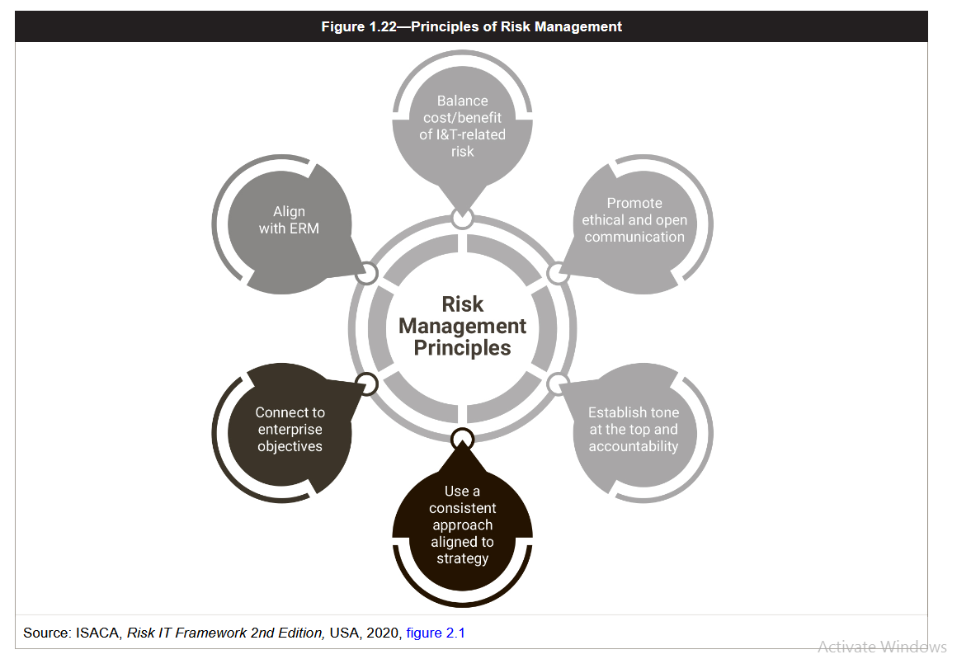

Slide 6
IT Risk in Relation to Other Business Functions
  IT risk is a critical part of business, taking on too much risk or exceeding the risk capacity may not only lead to the loss of investments, but also jeopardize the business viability resulting in its catastrophic failure.
  While the risk practitioner is primarily concerned with IT risk, this is just a subset of business risk. This requires the risk practitioner to understand the risk culture of an enterprise and to use it to drive or inform the IT risk strategy.
  When analyzing and assessing IT risk, the risk practitioner must not calculate risk solely from the perspective of IT, rather they need to ensure that both technical and nontechnical elements of risk have been properly considered.
  A failure of an IT system has an impact on the IT department, and it most likely will have a much greater impact on the business which relies and depends on that system more than IT alone.

Slide 7
Risk and Business Continuity
  IT risk management is closely linked with business continuity.
  The business function of business continuity is concerned with the preservation of critical business functions and the ability of the enterprise to survive an adverse event that may impact the ability of the enterprise to meet its mission and goals.
  Through risk management, the enterprise attempts to reduce all IT risk to an acceptable level.
  Although the controls and efforts of IT risk management may not prevent a failure, the risk practitioner works with the incident management and business continuity teams to identify possible threats and put in place the mechanism to detect, contain and recover from an adverse event if it should happen.

Slide 8
Risk and Audit
  The audit function is an important part of corporate governance that provides management with assurance regarding the effectiveness of the control framework, IT risk management program and compliance.
  IS audits should be conducted by skilled and independent personnel able to review risk, identify vulnerabilities, document findings and provide recommendations on how to address audit issues.
  An audit is a structured review that requires competence and knowledge in the subject matter of the area being audited.
  If the IS auditor is not familiar with the technology being used, the significance of operating conditions or the requirements of the enterprise, the audit may be inaccurate and provide limited value.

Slide 9
Risk and Information Security
  IT risk management drives the selection of controls and justifies their initial and continued operation.
  If the IT risk management activity is not conducted properly, information security controls are almost certain to be incorrectly designed, poorly implemented and improperly operated.
  Every control should be traceable back to a specific IT risk that the control is designed to mitigate, and the risk practitioner should be able to demonstrate the purpose of each control and explain the reasoning behind its selection.

Slide 10
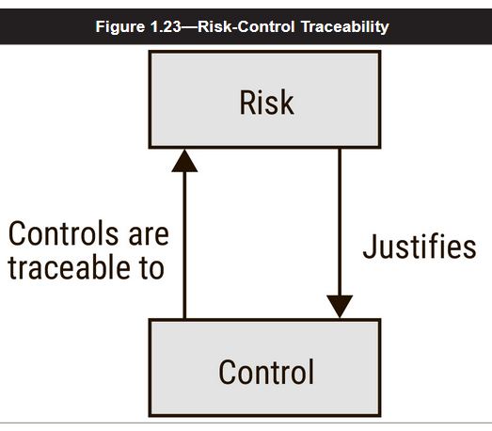
Control Risk
A control is chosen to mitigate a risk, but if the control is not operating correctly then the control may not prevent a failure or compromise, in addition to creating a false sense of security.
The selection of the wrong control, the incorrect configuration of the control, the improper operation of the control, the failure to monitor and review the control or the inadequacy of the control to address new threats may introduce the risk of control failure.
When selecting a control, consider a number of factors for finding the most effective and efficient control.
Understand that there are different types of controls and understand the capabilities and limitations of the controls being recommended. Will give you the ability to Provide the risk owner with multiple control options.

Slide 11
Project Risk
  Many projects fail; in fact, numerous studies of IT projects have indicated that a majority of IT projects could be considered failures.
  Failure of a particular project may be defined by overcoming its allocatted budget or the allotted time scheduled, or if it does not deliver what it promised.
  A project may also be deemed a failure if it delivered what it promised but the deliverables did not meet customer needs and expectations.
  The failure of an IT project may pose a significant risk to an enterprise, as lost market share, failure to seize new opportunities or other adverse impacts on customers, shareholders and staff.
  Identifying the risk associated with a project and successfully managing that risk is very likely to result in higher levels of project success and stakeholder satisfaction.

Slide 12
Change Risk
  Risk is not static.
  Changes in technology, regulations, business processes, functionality, architecture, users and other variables that affect the business and technical environments of the enterprise introduce a wide range of risk associated with systems in operation.
  The risk level of a particular system may also change because of intentional changes to its configuration or architecture that result in the controls that were originally effective as designed becoming ineffective.
  The risk practitioner is tasked with managing risk on a continuous basis, which means that they must stay aware of emerging risk that may be associated with new threats, new technologies, changes in environment, culture and changes in legislation and/or regulation.
  All of these changes may affect the risk posture of the enterprise and result in a new level of risk not adequately addressed in earlier risk-identification efforts.

Slide 13
Organizational Assets
  An asset is something of either tangible or intangible value that is worth protecting.
  Examples of assets commonly found in organizations include:
      Data, information and knowledge
      Reputation
      Brand
      Intellectual property
      Facilities
      Equipment
      Cash and investments
      Customer lists
      Research
      People
      Service/business process

Slide 14
People
  Many enterprises are vulnerable to the loss of a key employee who may be the only person with knowledge in a certain area or specific expertise.
  Failures by management to identify key employees and ensure that they are supported through cross-training, sufficient documentation of key processes performed, and incentive programs are unfortunately common.
  Whether the loss occurs as a result of retirement, illness or recruitment by another organization, it may leave the enterprise in a precarious and vulnerable position.

Slide 15
Technology
  Technology changes rapidly, and new technologies are always being developed. In addition to being aware of new technologies and the risk that they pose, the risk practitioner should also consider the risk associated with outdated technology, which is often overlooked (ignore).
  Equipment that is no longer supported or past its mean time between failure (MTBF) may be particularly vulnerable.
  Lack of patching and updating of systems or applications leaves them vulnerable to malware or misuse, and older systems may require expertise that is not readily available to maintain (potentially increasing key-person dependency).
  Older systems may also lack sufficient documentation, may result in becoming reliant on one vendor to maintain or be difficult to support in terms of replacement parts.
  When systems are scheduled for disposal, they may contain sensitive data. The risk practitioner should be sure that sufficient procedures are in place to securely dispose of such data and that these procedures are consistently followed.
  Common methods of destroying data include overwriting, degaussing and physical destruction of the equipment.

Slide 16
Data
  Many enterprises consider data to be extremely valuable.
  Customer lists, financial data, marketing plans, human resources (HR) data and research are some examples of data-related assets that should be protected.
  The systems that host, process or transmit the data must ensure that data are protected at all times, in all forms (paper, magnetic storage, optical storage, reports, etc.) and in all locations (storage, networks, filing cabinets, archives, etc.).
  To ensure the proper handling, use and safeguarding of data, the enterprise should clearly identify the business value of the data.
  The appropriate data security classification should also be defined, which describes the various data elements to be considered, the potential impact should the confidentiality, integrity or availability be compromised and the corresponding controls to ensure such risk is reduced to an acceptable level.

Slide 17
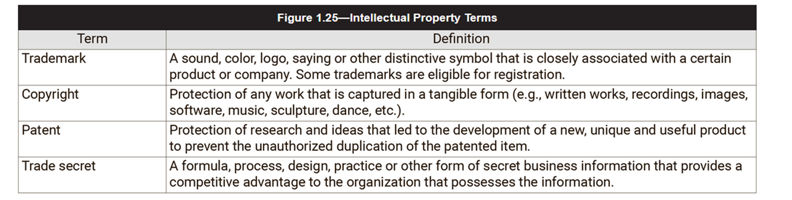
Intellectual Property
  Trademarks, copyrights, patents, trade secrets and other items associated with the reputation and goodwill of the enterprise are examples of intellectual property.
  Intellectual property is a class of information that is treated with special care because it may represent the future earnings potential of the enterprise.
  Failure to protect intellectual property may result in the loss of competitive advantage.
  All employees and business partners should be bound by nondisclosure agreements (NDAs) and reminded of their responsibility to protect the intellectual property of the enterprise and handle it properly.
  Key terms related to intellectual property are described in figure 1.25.

Slide 18
Asset Valuation
  Not all assets are equally important; many are absolutely critical to business operations, while others provide indirect support and benefits.
  The risk practitioner should try to determine the importance of assets in the context of organizational activities so that priority may be given to protecting the most important assets first and addressing less significant assets as time and budget allow.
  Effective valuation also protects the organization from paying more in protection than the value of the asset.
  The calculation of the value an asset provides to an enterprise is not as straightforward as it may initially appear.
  Many enterprises use a quantitative approach that assigns a monetary value, which can be difficult when the value influences or drives intangibles such as confidence, morale or market perception.
  Contributing factors to calculating asset value include:
    Financial penalties for legal noncompliance
    Impact on business processes
    Damage to reputation
    Additional costs for repair/replacement
    Injury to staff or other personnel
    Violations of privacy
    Breach of contracts
    Loss of competitive advantage
    Legal costs

Slide 19
Asset Inventory and Documentation
  An important part of managing risk is the identification and inventory of the assets of the organization.
  As changes are made to systems and new equipment is installed or older equipment is retired, the asset inventory must be updated to reflect what assets, systems and equipment the organization is currently using.
  For hardware asset inventories, they should list all equipment, supplier, acquisition date, original cost, actual cost, the location, owner of the equipment and other data required for maintenance, insurance and warranty purposes.
  Data/information asset inventories should list the system(s), source, acquisition method, business use, business criticality, availability, completeness, processing, storage, transmission, sensitivity, classification and the business owner.
  Often the task of identifying, inventorying and mapping data is a common requirement in a number of regulatory, statutory and contractual agreements and with the advent of legislation relating to privacy, such as the European Union's General Data Protection Regulation (EU GDPR), and the PCI DSS.
  Additionally, it is referenced frequently as a requirement in industry recognized standards, such as ISO/IEC 27001, and common industry accepted best practice such as the NIST Cybersecurity Framework and Center for Internet Security Top 20 Critical Security Controls.

Slide 20
  Enterprise Risk Management
    ERM helps to protect companies from any sudden threat or loss. The simple question that ERM practitioners attempt to answer is: “What are the major risks that could stop us from achieving the mission?”
    In simple terms, risk can be viewed as a challenge to achieving objectives, and risk management as the activity undertaken to predict challenges and lower their chances of occurring and/or their impact.
    Effective risk management can also assist in maximizing opportunities, and the risk practitioner should keep this upside/downside duality of risk in mind.
    For example, a risk decision might take the form of potential benefits that may accrue if opportunities are taken versus missed benefits if those same opportunities are foregone.

Slide 21
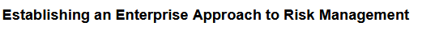
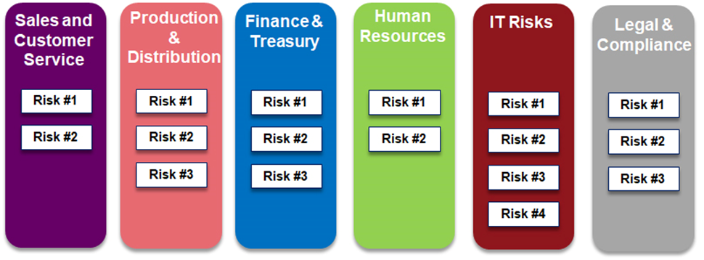
Traditionally, organizations manage risks by placing responsibilities on business unit leaders to manage risks within their areas of responsibility.
  For example, the Chief Technology Officer (CTO) is responsible for managing risks related to the organization’s information technology (IT) operations, the CFO is responsible for managing risks related to financing and cash flow, the Chief Operating Officer is responsible for managing production and distribution, and the Chief Marketing Officer is responsible for sales and customer relationships, and so on.
  Each of these functional leaders is charged with managing risks related to their key areas of responsibility.
  This traditional approach to risk management is often referred to as silo risk management whereby each silo leader is responsible for managing risks within their silo

Slide 22
Limitations with Traditional Approaches to Risk Management
  Limitation #1: There may be risks that “fall between the silos” that none of the silo leaders can see. Risks don’t follow management’s organizational chart and, as a result, they can emerge anywhere in the business. As a result, a risk may be on the horizon that does not capture the attention of any of the silo leaders causing that risk to go unnoticed until it triggers a catastrophic risk event.
  Limitation #2: Some risks affect multiple silos in different ways. So, while a silo leader might recognize a potential risk, he or she may not realize the significance of that risk to other aspects of the business.
  Limitation #3: Third, in a traditional approach to risk management, individual silo owners may not understand how an individual response to a particular risk might impact other aspects of a business.

Slide 23
ERM seeks to create a top-down, enterprise view of all the significant risks that might impact the strategic objectives of the business. In other words, ERM attempts to create a basket of all types of risks that might have an impact – both positively and negatively – on the viability of the business.
Enterprise risk management (ERM) is a firm-wide strategy to identify and prepare for hazards with a company's finances, operations, and objectives.
Enterprise risk management comprises the methods, processes, and practices that are leveraged to manage the various risk faced by an organization.
As a management program, they inform decisions and align courses of action used to both take advantage of an opportunities or to reduce the potential impact of an event should it occur.
As a function, they identify threats, analyze potential impact and likelihood of occurrence, and assess viable treatments to discrete events in context of the organization environment, capabilities and controls, and strategic goals.
Successful ERM strategies can mitigate operational, financial, security, compliance, legal, and many other types of risks

Slide 24
A chief risk officer (CRO), for instance, is a corporate executive position that is required from an ERM standpoint.
  The CRO is responsible for identifying, analyzing, and mitigating internal and external risks that impact the entire corporation.
  The CRO also works to ensure that the company complies with government regulations and reviews factors that could hurt investments or a company's business units.
  The CRO's mandate (authorization) will be specified in conjunction with other top management along with the board of directors and other stakeholders.
  A good indication that a company is working at effective ERM is the presence of a chief risk officer (CRO) or a dedicator manager who coordinates ERM efforts.

Slide 25
ERM Practices
Pros
May make a company more prepared for
risks and uncertainties
May leave employees more satisfied
with the future state of the company
May result in greater customer service as
companies are prepared for certain
situations
May result in efficient reporting to upper
management that enhances decision making
May lead to more efficient company
wide operations
Cons
May not accurately assess the financial impact or likelihood of an outcome
Often requires time investment from a company in order to be successful
Often requires capital investment from a company in order to be successful

Slide 26
COSO ERM Framework
(The Committee of Sponsoring Organizations)
According to the COSO ERM framework, ERM encompasses:
  Aligning risk appetite
  Enhancing risk response
  Reducing operational surprises
  Identifying and managing multiple and cross-enterprise risk
  Seizing opportunities
  Improving deployment of capital
The COSO ERM cube was published in 2004 and it is a well recognized ERM framework.
In simple terms, in order to achieve a successful ERM initiative, an organization needs to implement all eight components shown on the front of the cube in relation to each of the four risks indicated across the top in all parts of the organization, as indicated on the side of the cube.
COSO use the cube to illustrate the links between business objectives on the top of the cube and the eight components shown on the front.
These categories of business objectives are also the categories of risks that organizations face.
The third dimension of the cube represents the business units of the organization and illustrates that ERM should be implemented across all locations and all activities within the organization.
Enterprise Risk Management – Integrated Framework © 2004. Committee of Sponsoring Organisations of the Treadway Commission (COSO).

Slide 27
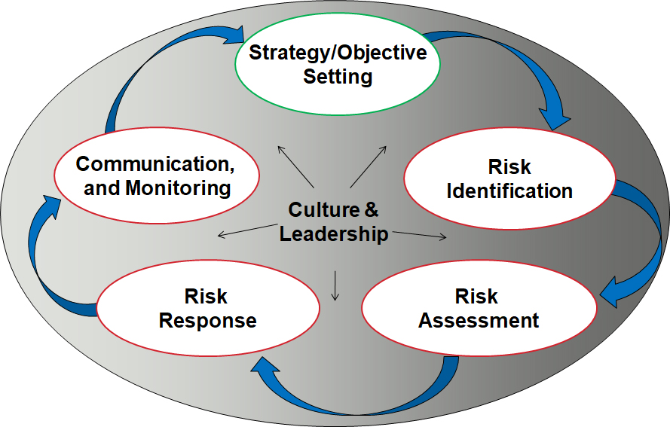
Leadership of ERM
  Given the goal of ERM is to create a top-down, enterprise view of risks to the entity, responsibility for setting the tone and leadership for ERM resides with executive management and the board of directors.
  They are the ones who have the enterprise view of the organization and they are viewed as being ultimately responsible for understanding, managing, and monitoring the most significant risks affecting the enterprise.
Elements of an ERM Process

Slide 28
Risk Hierarchy
IT risk is a component of the overall risk universe of the enterprise.
Other types of risk an enterprise faces include:
    Strategic risk
    Environmental risk
    Market risk
    Credit risk
    Operational risk
    Compliance risk
In many enterprises, IT-related risk is considered to be a component of operational risk . However, even strategic risk can have an IT component to it, especially where IT is the key enabler of new business initiatives.
The same applies for credit risk, where poor IT (security) can lead to lower credit ratings.
  There are several published risk frameworks and standards, most of which reflect that IT risk is part of a risk hierarchy (figure 4.7), with business strategic risk at the highest level

Slide 29
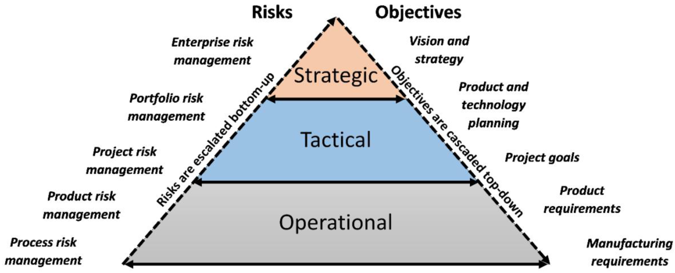
The strategic level is where choices are made about risk in relation to innovation and plans for delivering the business strategy. The other three levels are concerned with the actual delivery of the enterprise’s strategy.
The focus at the program and project levels is on medium-term goals to deliver the strategic objectives of the organization.
The stress at the operational level is on short-term goals to ensure ongoing continuity of business services.
At a minimum, risk needs to be properly analyzed; even if no immediate action is taken, because the awareness of risk may and often will influence strategic decisions for the better. Often, the most damaging IT risk is one that is not well understood or communicated.

Slide 30

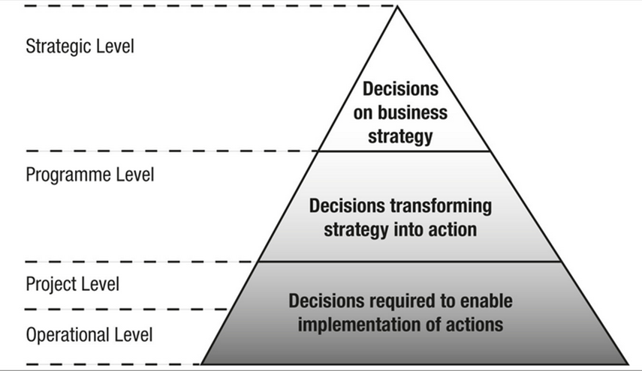
At the strategic level, it needs to be understood that risk taking is an essential element of business today and success comes to those enterprises that detect, identify, and manage risk most effectively.
At the portfolio level, the enterprise IT investments are differentiated into various categories. These investment categories need to be treated differently from each other—both in terms of analysis of risk (nature, likelihood, impact, etc.) and benefits or returns
Example: enterprise resource planning [ERP]) these systems function as the basic engine for running day-to-day business operations. The risk to the business of any failure of such investments may be highly damaging to business reputation and customer relations.

Slide 31
Examples: In the business case, risk management is applied to the identification and analysis of risk, which results in the evaluation and optimization of the risk or return for the IT-enabled investment for which the business case is made.
In executing program management, risk management is seen as managing the risk embedded in the various interlinked activities (e.g. results chain) that have been identified and recognized as part of the program.
At the project level, risk management is applied so that the new or enhanced capabilities that have been defined as a result of doing the project are actually delivered. In this case, risk management encompasses a number of aspects in the process of project execution such as risk detection and identification, analysis (including quantification, likelihood and impact analysis), handling strategies, and monitoring
Integrating risk management into the project management activities results in better project performance in terms of reducing cost and schedule overruns while delivering to scope.

Slide 32
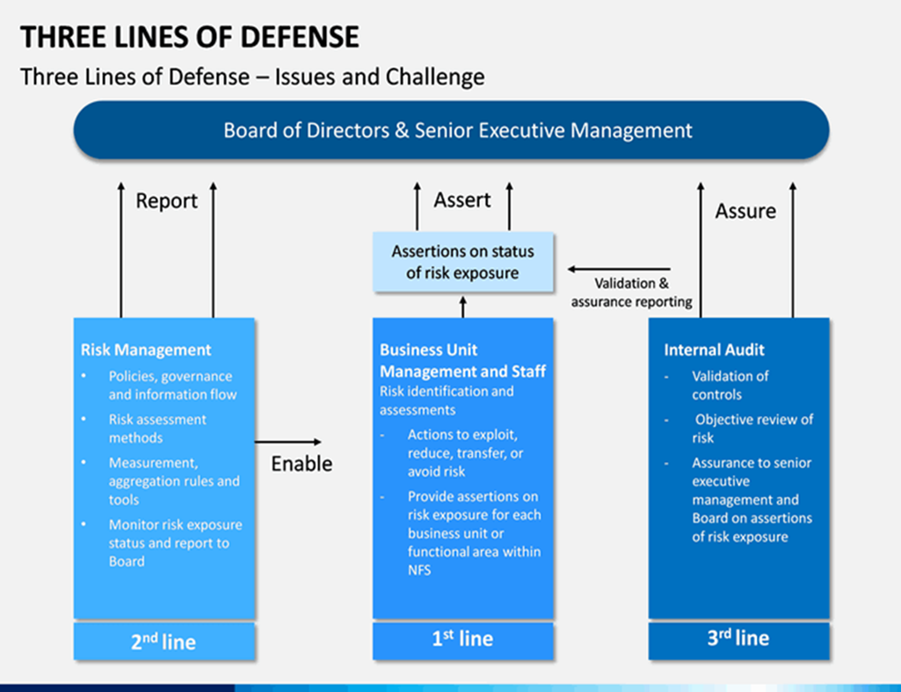
Three Lines of Defense
  The three lines of defense has been implemented by a variety of organizations in order to better enhance enterprise risk management capabilities across the whole of the organization various lines of business, establishing a more robust ERM program
The First Line of Defense: Operational Management
  The first line of defense is often implemented by the business unit, component or business function that performs daily operation activities, especially those that are the front lines of the enterprise.
  In this case they are expected to:
    Ensure the Proper control environment in their business unit.
    Implement risk management policies regarding roles and responsibilities, especially in activities that lead to corporate growth. They are expected to be fully aware of the risk factors that should be considered in every decision and action.
    Be able to execute effective internal control in their business units, as well as the monitoring process and maintaining transparency in the internal control itself.

Slide 33
The Second Line of Defense: Risk and Compliance Functions
  The second line of defense is typically comprised of risk management and compliance functions, where the expectations are to:
    Establish business-aligned risk management frameworks.
    Develop, monitor and oversee the process and operation of the enterprise overall risk management program capabilities.
    Monitor and ensure that business functions operate in accordance with the enterprise risk management policies, standards, and procedures.
    Monitor and report to the appropriate stakeholders on the enterprise current risk profile, posture and exposure, changes thereof, the status of any ongoing risk mitigation activities, and significant, credible threats faced by the enterprise.
  Within the second line of defense, risk management functions are focused to ensure that first-line defenses are properly designed, implemented and operating as intended.

Slide 34
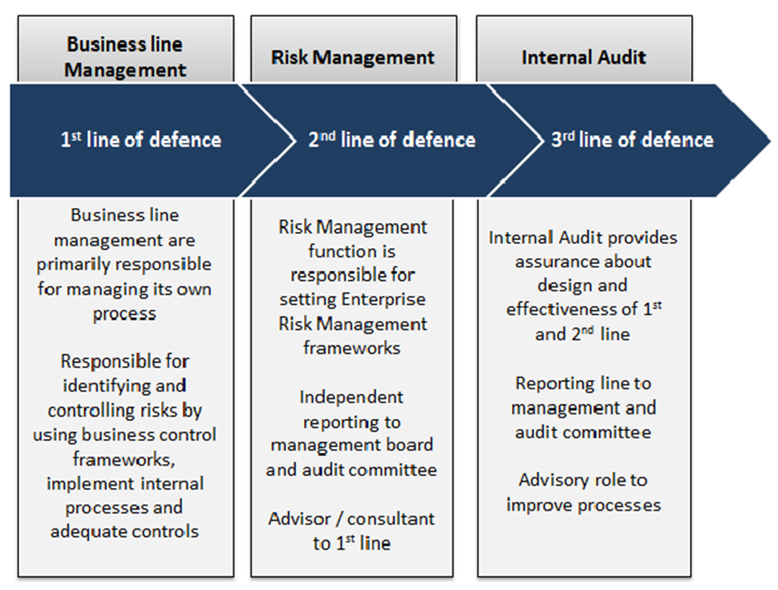
The Third Line of Defense: Audit
  The third line of defense consists of gaining the appropriate level of assurances to senior management and the governing body through independent and objective reviews performed by the enterprise internal audit capability and external audit (if applicable).
  An internal auditor is expected to:
    Assess conformance of the risk management program against the organizationally adopted and approved standard
    Review and evaluation the design and implementation of risk management holistically.
    Ensure the efficacy of the first and second lines of defense.

Slide 35
The Role of the Risk Practitioner within the Three Lines of Defense
The risk practitioner may be called to speak to the design, implementation, effectiveness and efficiency of first- or second-line processes, practices, activities and controls and provide the appropriate context, based on the desired level of assurance required
The risk practitioner often works across the first two lines of defense within an organization, while audit provides the governing board and senior management the independence and objectivity needed to report on the conformance with the applicable standards and frameworks identified by the risk practitioner and adopted by the organization.
the risk practitioner is positioned to act in an advisory capacity on the variety of threats and risk being faced, the analysis and assessment of risk, the selection of appropriate risk response and reporting on changes to the enterprises risk posture.

Slide 36
Risk Profile
Risk profile is broadly a factor of:
  Your risk capacity,
  Which measures how much you can withstand negative performance in your investments without jeopardizing your ability to reach your goal.(Risk capacity is the maximum amount of risk that an organization is able to take on)
  Your risk tolerance
  The risk you need to take to achieve your planned goals
Changes in the organizational risk environment may prompt the complete re-evaluation at any time.
Each organization has its own unique risk profile, based on the assets it wants to protect, the goals it wants to achieve, its ability to handle risks and its willingness to do so.
Organizations use risk profiles to align their strategy and actions with their risk appetite, that is, the level of risk they are willing to accept after the relevant controls have been put in place
Changes in the risk profile may be the result of numerous factors, including:
        New technologies
        Changes to business procedures
        Mergers or acquisitions
        New or revised regulations
        Changes in customer expectations
        Actions of competitors
        Effectiveness of risk-awareness programs

Slide 37
Risk Appetite and Risk Tolerance
  To effectively govern enterprise and IT risk, there must be an:
    Understanding and consensus with respect to the risk appetite and risk tolerance of the enterprise
    Awareness of risk and the need for effective communication about risk throughout the enterprise
    Understanding of the elements of risk culture
Risk Appetite
Risk appetite is the amount of risk an entity is prepared to accept in pursuit of its mission (or vision).
There is no absolute norm (pattern) or standard of what constitutes acceptable and unacceptable risk.
When considering the risk appetite levels for the enterprise, two major factors are important:
  The capacity of the enterprise to absorb loss (e.g., financial loss, reputation damage)
  The (management) culture or predisposition toward risk taking—is it cautious (careful) or aggressive? What is the amount of loss the enterprise wants to accept to pursue a return?
Senior management has the responsibility for defining the organization risk appetite.
The risk appetite should be well-defined, documented, and communicated with the appropriate staff who make decisions specific to risk within the organization.
A clearly defined risk appetite also enables those performing risk analysis to consistently and effectively analyze the risk and recommend reasonable treatments, allowing the risk practitioner to focus on the risk that has the highest likelihood and greatest impact for the organization and exceeds the defined risk appetite of the organization.

Slide 38
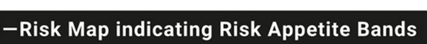
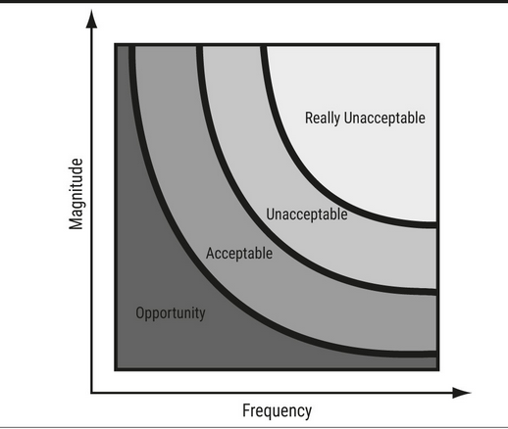
In practice, the organization risk appetite can be easily visualized in terms of combination of frequency and magnitude of risk. The use of a risk map, where the individual bands represent defined levels of risk, can quickly summarize the organization risk appetite.
In the figure the four bands of significance are defined:
Really unacceptable risk—The enterprise estimates this level of risk far exceeds both their normal risk appetite and defined risk tolerances. Any risk found to be in this band should trigger an immediate risk response.
Unacceptable risk—Indicates elevated risk (ie., also above acceptable risk appetite). The enterprise might, as a matter of policy, require mitigation or another adequate response to be defined within certain time boundaries, should the risk meet the criteria of defined risk tolerance levels
Acceptable risk—This indicates normal acceptable levels of risk, usually with no special action required except for monitoring the risk and current controls or other responses. This normally considered as an accepted cost of business, where costs associated with the realization of the risk could be absorbed costs during the course of business and normal activities.
Opportunity—This risk is below the defined risk appetite, where (cost) saving opportunities may be found by decreasing the degree of control

Slide 39
Risk Tolerance
Risk tolerance is the acceptable level of variation, above the defined risk appetite, that management is willing to allow for a particular risk as the enterprise pursues its objectives.
This is often best measured in the same units as those used to measure the related objective. In other words, risk tolerance is tolerable deviations from the level set by the risk appetite definitions. For example, standards require projects to be completed within the estimated budgets and time, but an overrun of 10 percent budget or 20 percent time are tolerated.
On risk appetite and risk tolerance, the following guidance applies:
Risk appetite and risk tolerance go hand in hand. Risk appetite is defined at the enterprise level and is reflected in policies set by the executives; at lower (tactical) levels of the organization, or in some entities of the organization, exceptions can be tolerated as long as the overall exposure at the enterprise level does not exceed the set risk appetite.
Any business initiative includes a risk component, so management should have the discretion to increase risk tolerance levels and pursue some new opportunities, based on specific and established criteria.
Risk appetite and tolerance should be defined and approved by senior management and clearly communicated to all stakeholders. A process should be in place to review and approve any exceptions to such standards.

Slide 40
Risk appetite and tolerance change over time. New technology, new organizational structures, new market conditions, new business strategy, and many other factors require the organization to reassess its risk portfolio at regular intervals, and also require the organization to reconfirm their risk appetite at regular intervals, triggering risk policy reviews.
In this respect, an enterprise needs to understand that the better risk management it has in place, the more risk that can be taken in pursuit or chase of return.
The cost of mitigation options can affect risk tolerance (allowance). There may be circumstances in which the cost/business impact of risk mitigation options exceeds an enterprise’s capabilities/resources, thus forcing higher tolerance for one or more risk conditions.
For example, if a regulation says that sensitive data at rest must be encrypted, yet there is no feasible encryption solution or the cost of implementing a solution is grossly impactful, then the organization may choose to accept the risk associated with regulatory noncompliance—a risk trade-off.
The subject of risk appetite goes to the heart of the relationship between the board, management, and chief risk officer (CRO) if there is one specified.
The board sets a risk appetite, which management adjust to by installing suitable controls to contain risk.
Meanwhile, the CRO or internal auditor Establish objective reports on the system of internal control. These audit reports review the extent to which residual risk, after taking account of controls, is acceptable, and that, in turn, indicates whether this risk falls in line with the defined risk appetite.
This dependency cycle is extremely important and hinges on respective perceptions of risk appetite.

Slide 41
Process to Determine Risk Appetite
One way to approach enterprise risk appetite is to go through the following five steps:
1. Define the company's strategic objectives and goals
By emphasizing what the business hopes to achieve, you can better articulate how much risk the company is going to assume in order to reach those ambitions and bring them to realization.
2. Create your risk appetite scale
After you have defined your business goals and objectives, the next step is to create a risk appetite scale.
For example, a company with a conservative financial risk appetite might shy away from investing in new technology to advance its growth objectives.
On the other hand, a health care organization with a high level of risk appetite might be willing to run trials on new medical procedures with unknown outcomes.
The scaling system helps you to determine how much risk tolerance you can assume for each risk.
Here is a sample of how you might label your scale and then place your risks under the appropriate section:
    Risk seeking: Aggressive risk taking is acceptable.
    Risk tolerant: Greater than normal risk taking is tolerable.
    Risk neutral: Risking taking is more balanced.
    Reasonably risk averse: Risk taking should be more cautious.
    Risk averse: Assuming as little risk as possible is ideal.

Slide 42
3. Communicate with leadership and stakeholders
  After the completion of the risk appetite scale, it's important that you relay your information to the company leaders and stakeholders so you can get their input.
  Senior executives need to give their insight about their expectations and how much risk they believe the organization should take to reach the business goals.
4. Write your risk appetite statement
  Writing a risk appetite statement is one of the most significant components of developing a risk appetite framework because it defines the company's risk appetite in a concise and clear manner to employees, leadership members and stakeholders.
  This information allows every one to make more informed and intelligent risk decisions within the company's established RAF.
  Therefore, when you write the RA statement, ensure to use common and simple language that is easy to understand for everyone.
5. Develop your tools for prioritization
  Once everyone understands the RAF they can operate within, develop the proper tools that help employees prioritize their work as defined by the risk appetite.
  When personnel have prioritization tools, they can make more informed daily decisions that align with the company's risk appetite framework, such as knowing what investing decisions to make based on where they fall on the risk appetite scale.

Slide 43
Example appetite levels defined by risk categories.

Slide 47
Example risk appetite statements
The following example demonstrates how risk appetite statements may guide organizational activity and decision making.
Example organizational appetite summary
Our risk appetite has been defined following consideration of organizational risks, issues and consequences.
Appetite levels will vary, in some areas our risk tolerance will be cautious in others, we are open/hungry for risk and are willing to carry risk in the pursuit of important objectives.
We will always aim to operate organizational activities at the levels defined below.
Where activities are projected to exceed the defined levels, this must be highlighted through appropriate governance mechanisms.
• Reputational risks: We have adopted a cautious stance for reputational risks, with a preference for safer delivery options, tolerating a cautious degree of residual risk and choosing the option most likely to result in successful delivery, thereby enhancing our reputation for delivering high quality, cost-effective services to the public.

Slide 48
• Personnel security risks: We have adopted a cautious stance for personnel security risks, and a cautious stance for security risks to staff. This includes both staff within and those travelling and based abroad. The Board will receive an annual assurance that appropriate travel advice and briefings are undertaken, and vetting, procedures and duty of care is in place.
• Financial risks: We have adopted a cautious stance for financial risks with reference to core running costs, seeking safe delivery options with little residual risk that only yield some upside opportunities. The Board will receive ongoing assurance through the annual governance statement that policies and procedures are in place in line with HMT guidance.
• Information risks: We have adopted a varied stance to information risk, to reflect the sensitivity of information as defined by Government Security Classifications (GSC). The Board will receive an annual assurance that guidance and procedures are in place and training undertaken by staff.
  - Tier 1 (Official/Official Sensitive): We have adopted an open stance, given the need for operational effectiveness with risk mitigated through careful drafting and/or limiting distribution;
  - Tier 2 (Secret): We have adopted a minimal stance to limit the potential damage from disclosure;
  Tier 3 (Top Secret): We have adopted an averse stance where disclosure would lead to serious risks to national security, economic well-being, or widespread loss of life.

Slide 49
Professional Ethics of Risk Management
  Risk is often impacted by professional ethics.
  It is easy to understand that an organization with poor ethical standards may be more susceptible to fraud or theft, but ethical risk may also apply to an enterprise that has poor management processes in place to identify errors, misuse or fraud.
  Ethics are related to an individual's perception of right and wrong and are not necessarily linked to the law.
  For example, in many organizations, it is acceptable to receive gifts from clients or suppliers, whereas in others it is not acceptable.
  To address the risk of a person violating the ethics policy of the enterprise, senior management must communicate policy to everyone and ensure that it is both visibly enforced and equally applicable to people at all levels of authority.
  Ethics policies that are unenforced or applied selectively are ineffective in directing behavior.
  As a risk practitioner who has earned the CRISC certification, ISACA has defined and set forth a Code of Professional Ethics to the professional conduct of members of the association and/or its certification holders.

Slide 50
ISACA certification holders shall:?
  1. Support the implementation of, and encourage compliance with, appropriate standards and procedures for the effective governance and management of enterprise information systems and technology, including audit, control, security and risk management.
  2. Perform their duties with objectivity, due diligence and professional care, in accordance with professional standards.
  3. Serve in the interest of stakeholders in a lawful manner, while maintaining high standards of conduct and character, and not discrediting their profession or the Association.
  4. Maintain the privacy and confidentiality of information obtained in the course of their activities unless disclosure is required by legal authority. Such information shall not be used for personal benefit or released to inappropriate parties.
  5. Maintain competency in their respective fields and agree to undertake only those activities they can reasonably expect to complete with the necessary skills, knowledge and competence.
  6. Inform appropriate parties of the results of work performed including the disclosure of all significant facts known to them that, if not disclosed, may distort the reporting of the results.
  7. Support the professional education of stakeholders in enhancing their understanding of the governance and management of enterprise information systems and technology, including audit, control, security and risk management.

